Slide 1
CMAC 3990.200
Systems Administration and Operations
Fall 2025 – Week 3.1 – September 9th, 2025
Directory Services and User Management
Network Hardware and Devices, LDAP, and SAMBA

Slide 2

Objectives
Weekly Info
SSH Tunnel Examples
  Local port forward
  SOCKS Proxy
Assignment 2 review
Directory Services
Lightweight Directory Access Protocol
Active Directory
Network Information Systems
Operating System Interoperability
VIP’s
  Multiple IP’s on a single interface
  Multiple interfaces
  Network interface bonding

Slide 3

Weekly Info
“Sometimes you need to visit the extremes to find the things that are valuable.” -unknown
Bank of America thinks there is a 20-50% chance we are living in a simulation.
Five Levels of Leadership
  Level 1 – Highly capable individual – makes productive contributions
  Level 2 – Contributing team member – contributes to a group, works well with others
  Level 3 – Competent Manager – Organizes people and resources towards a planned goal
  Level 4 – Effective Leader – Catalyzes commitment, stimulates group performance
  Level 5 – Builds enduring greatness through personal humility and professional will.
Attendance
Good of the class
  No Class on Tuesday August 16, 2025!

Slide 4
Assignment Documentation Expectations
Documentation expectations examples:
  Edit the network configuration file /etc/sysconfig/network-scripts/ifcfg-bond0
    Updated the following information in the network configuration file:
      IPADDR=147.64.243.115
      HOSTMASK=255.255.254.0
      DNS1=147.64.242.100
      DNS2=147.64.242.101
  Restarted the network services to apply configuration changes
      systemctl restart network
  Added entry to /etc/fstab file for persistent mount
    147.64.243.115:/data /data nfs bg,rw,sync,hard,intr 0 0
  Updated and rebooted the system
      dnf –y update; reboot
  Any additional descriptions or pictures that may be helpful!

Slide 5
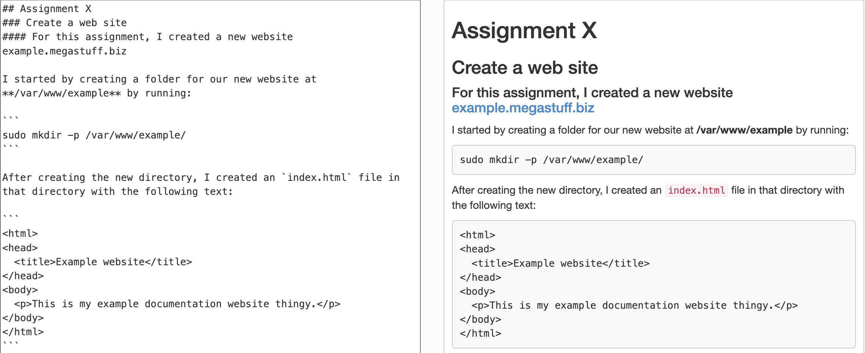
Documentation Options…
Markdown!

Slide 6
Class Presentations
Group project and presentations!
  1-2 People per group
  Presentations approx. 10 minutes each
  Include 4-5 page paper discussing topic,
  history, and related technologies
  300 points total (18.8% of final grade)
  Presentations on 12/2/2025 and 12/4/2025
  Optional other topics with instructor approval
    E-Mail Professor with ideas
  Project/group assignments next week
    September 18th, 2025
  Project proposal required!
    Proposal due as an upcoming homework assignment – HW 5? Maybe?
Details: https://jpatalon.cs.edinboro.edu/cmac3990/Presentation%20Information.pdf
Example Presentation Topics
DNS/DHCP | SELinux
SAN | DFS
Virtual Machines | ACL's
Hyper-converged | Pen Test
Clustering | NTP/PTP
Containers | IPv4/IPv6
NAS | Disaster Recovery
Questions?

Slide 7
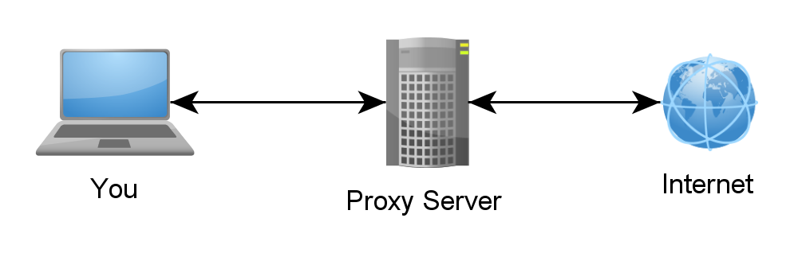
SSH Tunnels
SSH Tunnels are secure and encrypted between endpoints!
Local port forwarding
  Similar to port forwarding on a router
  ssh -L source_port:destination_host:destination_port user@host.tld
    Ex: ssh –L 8080:cmac3990-110.cs.edinboro.edu:80 cs_student@jpatalon.cs.edinboro.edu
    This command opens an encrypted tunnel between my local machine and ssh server jpatalon.cs.edinboro.edu
    Traffic sent to localhost port 8080 is redirected to cmac3990-110.cs.edinboro.edu port 80

Slide 8
SSH Tunnels
SOCKS (Dynamic) Proxy
  Allows for website proxying
  Can be used to allow connections around firewalls
    Connect to your cmac3990 web server from anywhere through an intermediate host
  ssh -D port user@host.tld
    Ex: ssh –D 55510 cs_student@jpatalon.cs.edinboro.edu
    This command opens an encrypted tunnel between your local machine and ssh server jpatalon.cs.edinboro.edu
    Web SOCKS traffic is sent through port 55510 to server jpatalon.cs.edinboro.edu, where it is then forwarded to the destination

Slide 9
SSH Tunnels
Combined SSH SOCKS proxy and local tunnels
  ssh –D 55510 –L 33890:147.64.243.110:3389 cs_student@jpatalon.cs.edinboro.edu
  This creates a tunnel through server jpatalon.cs.edinboro.edu
  This allows us to do both a local port forward and a dynamic port forward
  Connecting to localhost port 33890 is forwarded to 147.64.243.110 port 3389 through jpatalon.cs.edinboro.edu
  A dynamic SOCKS proxy is set up through localhost port 55510
  The connection is encrypted between the localhost and jpatalon.cs.edinboro.edu

Slide 10
SSH Tunnels
Multi-hop ssh tunnels
ssh -D 55555 -L 55556:127.0.0.1:55556 -L 55557:127.0.0.1:55557 cs_student@jpatalon.cs.edinboro.edu
ssh -D 55556 -L 55557:127.0.0.1:55557 user@cmac3990-1##.math.cs.edinboro.edu

Slide 11
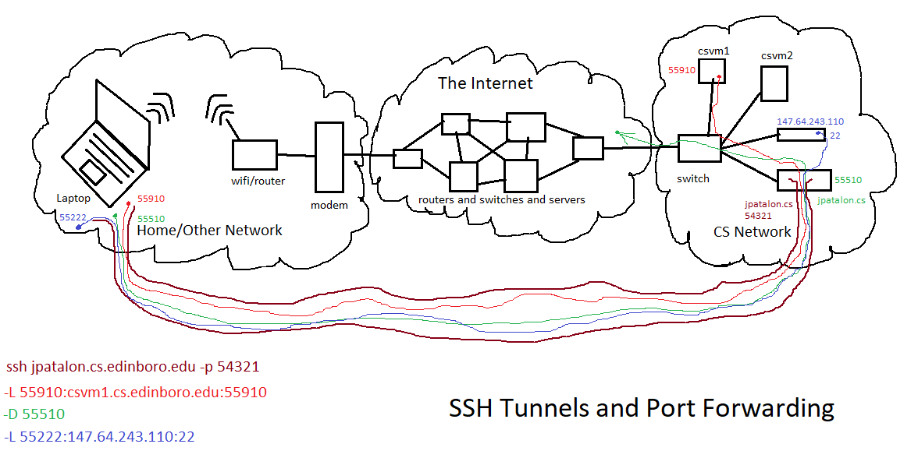

Slide 12

Assignment Reviews
SSH Tunnel Example and Usage
  More better pictures and walkthrough?
  https://jpatalon.cs.edinboro.edu/cmac3990/SSH&TunnelHelp.pdf
Assignment 2 Review
  VM Initial Setups

Slide 13
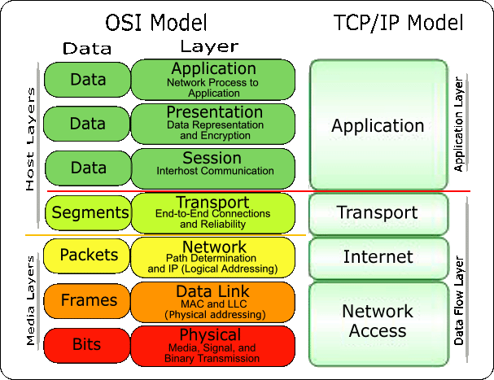
Directory Services
Organize resources into relationships within a domain
Used to maintain lists of people, computers, servers
Mostly-read type of database
Allows for attributes to be specified for objects
Ease of grouping by type of resource
Objects will inherit characteristics
from parent objects
Application Layer protocol
Allows for centralized security
administration!!!

Slide 14
Directory Services
Namespaces – A set of names that have a common purpose
  Account names, printer, names, FQDNs, MAC addresses, IP addresses, etc.
Nameservice – Associates attributes with the names in a given namespace
  User directory (namespace) uses the account names namespace as a set of unique keys, and associates the unique identifiers (UID’s) and other characteristics with the user account name.
Flat namespace – No hierarchy within the namespace structure
  WINS, Linux User ID’s, etc.
Hierarchical namespace – Separation of names into a
hierarchy, creating unique items
  AD or LDAP users, directory structures, etc.
  Ex: Multiple files with the same name in different locations

Slide 15
Directory Services
Namespace rules:
  Policies for naming, longevity, locality, exposure
  Procedures for adding, changing, and deleting
  Centralized management
Document your policies and procedures!
What is allowed, what is not allowed?
  Profanity or offensive names?
  Special characters?
Naming categories
  Thematic – Names follow a theme (planets)
  Functional – Names describe function (dbserver01)
  Descriptive – Names that provide factual information (finance)
  Formulaic – Names that fit a formula (pc-29875)
  Hybrid – Combining different naming elements (nyc-marketing)

Slide 16
Directory Services
Namespaces Issues
  Possibility for similar or duplicate names
    server.math.cs.edinboro.edu or server.cs.edinboro.edu
  Exposing sensitive information
    Server location or software running on server
  Migration of services to different hosts
    Aliases or CNAME’s and VIP’s should be used wherever possible
    DFS names for Windows file servers
  Conflicting standards
    Merging namespaces
  Easy vs. complicated names
  Removal or reuse of names
    Never remove, never reuse?
    Retain historical information in CMDB

Slide 17
Directory Services
Nameservices
  Associate data with individual names in a namespace, and may link to names in another namespace
  Define what is mandatory, what is optional, and how to update
  Consistency is key!
  Authoritative body
    Master/Slave, HR, Finance, etc.
  Capacity and scaling
  Reliability – Fault Tolerant and Highly Available
  Authentication mechanisms and Access Policies
    Connection protocols, encryption standards, who and how
  Change policies and procedures
    Who, What, How
    Management
  Automation!

Slide 18
Directory Services
X.500
  Developed to support X.400 mail functions
  Multiple additional data models to describe object classes and authentication framework
  Includes the Directory Access Protocol (DAP)
  Uses OSI network model (as opposed to TCP/IP model)
    Alternatives developed to use TCP/IP model
    Modern versions can use TCP/IP model
      LDAP
  Contains a single Directory Information Tree (DIT)
    Hierarchical organization of entries
    Distributed among Directory System Agent (DSA) servers
    Entries consist of a set of values used to create a Distinguished Name (DN)
  Replaced with LDAP
    LDAP doesn’t provide as much detail

Slide 19
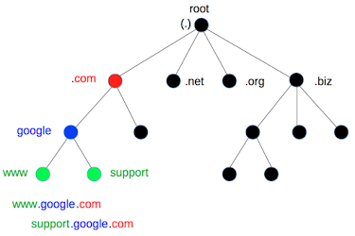
Directory Services
Types of directory services:
  Domain Name System (DNS)
  Network Information System (NIS)
  NetInfo
  Banyan VINES (1984 – 1997)
    First scalable directory services offering
    VINES Protocol Stack
    16-bit subnet, 32-bit address
  Windows NT Domains
    Created for Windows machines
    Replaced by LDAP-Based Active Directory
  Lightweight Directory Access Protocol (LDAP)
  Workgroups
Notes:
Banyan VINES address would be similar to a MAC address

Slide 20
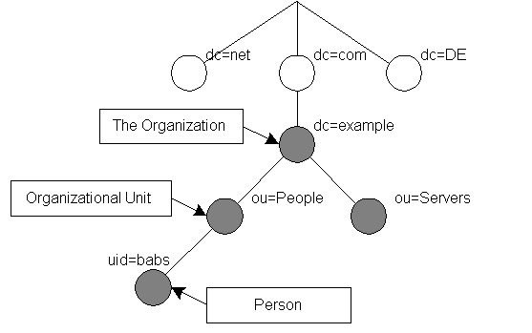
Directory Services
Network Information Service (NIS)
  Originally called Yellow Pages
  Maintains user and computer names
  Developed by Sun
  Upgraded to NIS+
    Enhanced security and authentication
    Hierarchical design
    Cumbersome and difficult to manage
  Replaced by LDAP, DNS, and DHCP
    Netmask information
    E-Mail information
    Host information

Slide 21
Directory Services
Lightweight Access Directory Protocol (LDAP)
  Organizes contact information
  Allows for ease of lookup
  Creates a “phone book” of user information
  Used in many companies of varying size
  Can be used for many other items
    Printers
    Encryption Certificates
    Network resources
  Provides for a “Single Sign On” (SSO)
    One user account across multiple systems
  Centralization of account management
  Provides a standard! (RFC 4510/4511)

Slide 22
Directory Services
Lightweight Access Directory Protocol (LDAP)
  TCP or UDP unencrypted port 389
  SSL/TLS Tunnel port 636
  Application Layer Protocol!
  Uses a Uniform Resource Locator (URL)
    ldap://host:port/DN?attributes?scope?filter?extensions
  Users identified by a Distinguished Name (DN)
    dn: cn=John Doe,dc=example,dc=com
  Additional attributes attached to DN
    cn: John Doe
    givenName: John
    sn: Doe
    telephoneNumber: +1 888 555 1232
    mail: john@example.com
    manager: cn=Barbara Doe,dc=example,dc=com
    objectClass: inetOrgPerson
    objectClass: organizationalPerson
    objectClass: person

Slide 23
Directory Services
Lightweight Access Directory Protocol (LDAP)
  DN: Distinguished Name
  CN: Canonical or Common Name
  DC: Domain Component
  SN: Surname
  OU: Organizational Unit
  SID: Security ID
  UID: User ID
Parts of the X.500 Directory Spec!

Slide 24
Directory Services
Lightweight Access Directory Protocol (LDAP) RFC’s
  RFC 1823: LDAP Application Protocol Interface (API)
    Informational, August 1995
  RFC 2307: Using LDAP for NIS
    Experimental, March 1998
  RFC 3062: LDAP Password Mod
    Proposed Standard
    Standards Track, February 2001
  RFC 4511: LDAP Protocol
    Proposed Standard
    Standards Track, June 2006
    Obsoletes older LDAP RFC’s!
      2251: LDAP v3

Slide 25
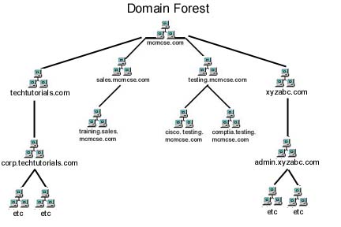
Active Directory
Microsoft’s proprietary implementation of LDAP
Term to describe a set of directory-based identity services
  Domain Services (devices, users, credentials, access rights)
  Lightweight Directory Services (simpler version of directory services)
  Certificate Services (Public Key Infrastructure)
  Federation Services (Single Sign On across networks)
  Rights Management (encryption authorization management)
AD Uses Microsoft’s versions of LDAP, Kerberos, and DNS
Arrangements of information about objects

Slide 26
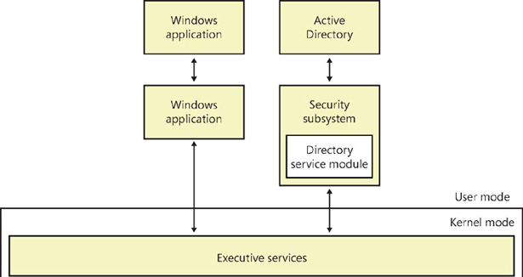
Active Directory – Physical Architecture
Part of security subsystem
User-mode application
  No direct access to OS or hardware
Requests must be validated
  Requests pass through executive layer
  Upon successful validation, requests from
  user-mode applications can be executed
Protects resources within the directory

Slide 27
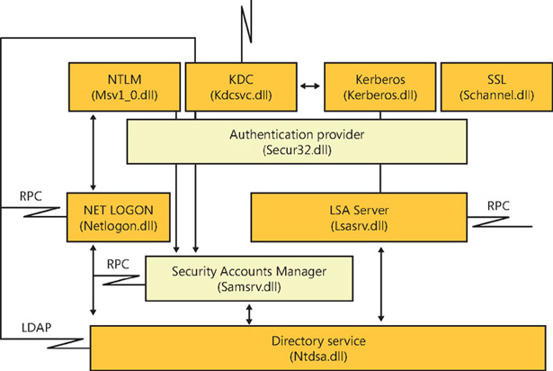
Active Directory – Physical Architecture
Component of the Local Security Authority (LSA)
  Manages local security policy
  Provides interactive login process
  Generates security ID’s
  Manages auditing
Authentication mechanisms
  NTLM – Lan Manager auth
  Kerberos & KDC – Key auth
  SSL – Secure Socket Layer
  Authentication provider
    Manages authentication

Slide 28
Active Directory – Physical Architecture
Login and access control mechanisms
  Net logon – Interactive logon via NTLM
  LSA Server – Enforce security policies
    Kerberos and SSL
  SAM – Enforce security policies
    NTLM
Directory Service component
  Provides actual directory services
  Allows for authenticated searches

Slide 29
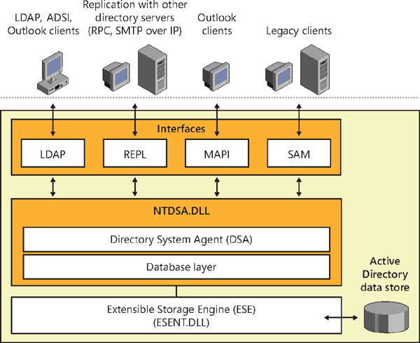
Active Directory – Physical Architecture
Different clients use different protocols
  LDAP is primary protocol for AD access
    Query and manage directory information
    LDAP versions 2/3 typically supported
    TCP port 389 standard communication
    TCL port 636 SSL communication
  REPL for replication
    Uses Remote Procedure Calls (RPCs) or SMTP
    Each domain controller is responsible for replicating
    changes to other DC’s in a multi-master approach
    No primary/backup domain controllers

Slide 30
Active Directory – Physical Architecture
Different clients use different protocols
  Message Application Programming Interface (MAPI)
    Primarily used by messaging clients for address book lookups
    RPC’s used to establish connection
    TCP/UDP port 135
    Replaced with LDAP
  Security Accounts Manager (SAM)
    Uses RPC calls
    Supports legacy NT clients (pre-windows 2000)
    Replication to older NT DC’s

Slide 31
Active Directory – Physical Architecture
Directory System Agent (DSA)
  Provides interfaces to communicate with
  clients and servers
  Directory service component
  Assigns unique Globally Unique ID’s (GUID)
    GUID’s never change!
  Enforces specific formats and types of information
  that can be associated with an object
    Schema – set of rules determining what can be stored
  Enforces security limitations
  Initiates replication
Database Layer
  Provides API for working with AD data
  Resides within directory service component

Slide 32
Active Directory – Physical Architecture
DSA protects database from applications
  Data is stored in flat files
  Database layer represents flat files as objects
  within a hierarchy
Extensible Storage Engine (ESE)
  Used by AD to read and write information
  Indexed storage for faster access
  Sequential storage for specific locations
  Transactional processing
    Discrete operations
    Provides for roll-back
  Provides for garbage collection and
  database defragmentation

Slide 33
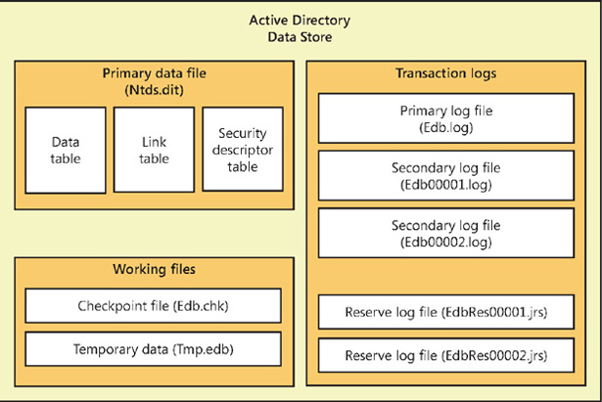
Active Directory – Physical Architecture
Data Store
  Physical storage of data
  Primary data file – Database file that holds the
  contents of the AD data store
  Checkpoint File – Tracks the point up to which
  the transactions have been committed
  Temp data
  Primary log file – Contains a record of all changes
  that have yet to be committed to the DB
  Secondary log files – Additional log files that
  are used as needed
  Reserve log files – Additional files that are used
  to reserve space if the primary log file is full

Slide 34
Active Directory – Physical Architecture
Primary Data file
  AD Data Table – Contains a record for each
  object in the data store, such as containers,
  objects, or any other data stored in AD
  AD Link Table – Used to represent linked
  attributes that refer to other objects in AD
    Containers that contain objects use links to point
    to the objects within the container
  AD Security Descriptor Table – Contains
  inherited security descriptors for each object.
  Prevents duplication of attributes by linking
  inherited security descriptors, increasing
  efficiency in the authentication and control
  mechanisms.

Slide 35
Active Directory – Logical Architecture
Objects defined as resources or security principals
  Resources include printers, rooms, devices
  Security principals describe accounts
    User or computer accounts and groups
    Given unique Security ID’s (SID’s)
Framework provides for different levels
  Forests, Trees, Domains
    A Domain is a group of objects in the same AD database
    Trees are collections of domains in a contiguous namespace
    Forests are collection of trees that share a common configuration
      Schema, catalog, structure, etc

Slide 36
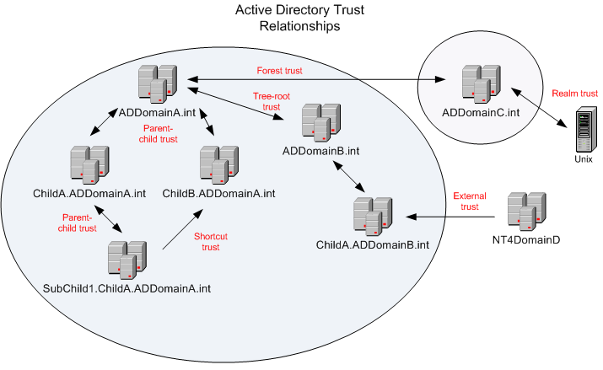
Active Directory – Logical Architecture
Trusts
  Join parent and child domains
  Join roots of domain trees
  Transitive
    A trusts B, B trusts C, therefore A trusts C
  Trusting Domain
    Establishes a trust. Allows access by user from
    trusted domain
  Trusted Domain
    A domain that trusts another. Users from trusted
    domains have access to trusting domains.
  Explicit Trust
    One way trust between two domains only
    Not transitive

Slide 37
Active Directory – Logical Architecture
Admins
  Enterprise admins
    Designated accounts for accessing enterprise functions
    Can manage and grant access to the resources in any
    domain in the AD forest
  Domain admins
    Administrators of a particular domain
    May have trusting permissions on parent domains

Slide 38
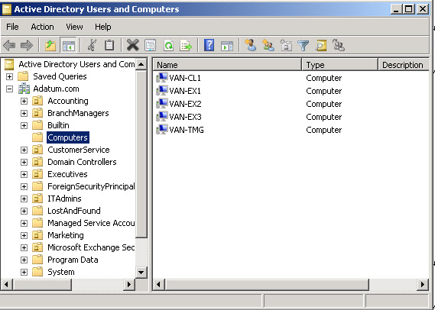
Active Directory – Logical Architecture
Namespaces and partitions
Top Level structure
  Multiple OU’s
  BuiltIn
  Computers
  LostAndFound
  Managed Service Account
  Program Data
  System
  Additional User-Created OU’s

Slide 39
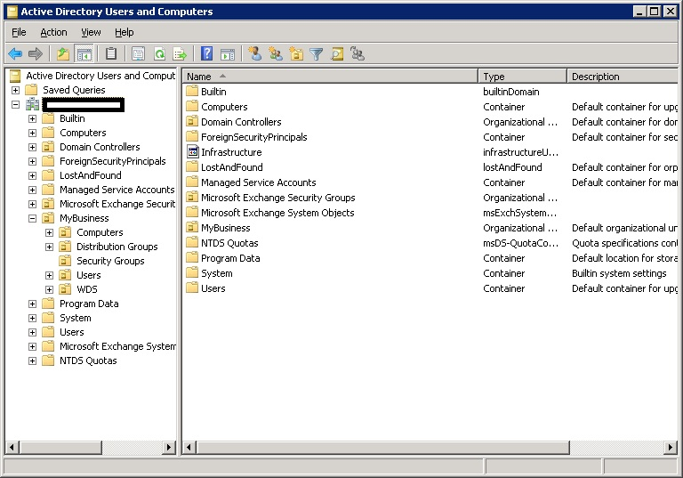
Active Directory
Users, Groups, Computers, Resources
separated into groupings
  Groupings are called Organizational
  Units (OU’s)
OU’s can be broken into sub-groups
  Hierarchical Structure
Individual items have properties that
describe the items
  Name, Address, Phone Number, etc

Slide 40
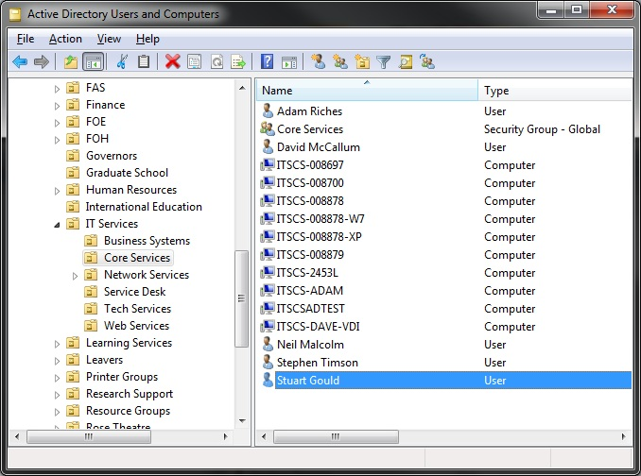
Active Directory
An item’s location within AD does NOT designate access permissions!
Separate task required to assign a member of an OU to a group
Automated tasks often used to create access groups based on OU membership
  Shadow Groups
Often divided by location, business function, service department, etc.

Slide 41
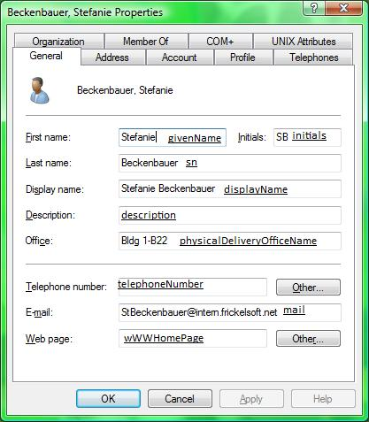
Active Directory
Various information about an item is stored
  First Name
  Last Name
  Description
  Work Phone
  Home Phone
  E-Mail address
  Much more!

Slide 42
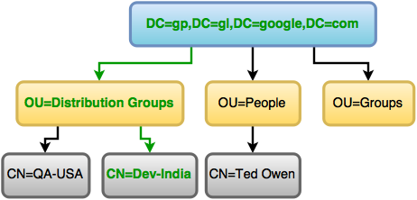
Active Directory
AD Information is stored on a Domain Controller
  Originally primary and backup domain controllers (PDC and BDC)
    Changes made on primary domain controllers
    Backup domain controllers are read only
    Backup domain controllers can be promoted if primary fails
  PDC/BDC obsoleted by AD services in Windows 2000
    All domain controllers considered equal
    No more read only domains!
  Read-Only domains return in Windows 2008
  Samba can replicate NT4 domains, including PDC
    Samba 4 can replicate LDAP AD domains!
  Non-domain controller servers are called
  Member Servers

Slide 43
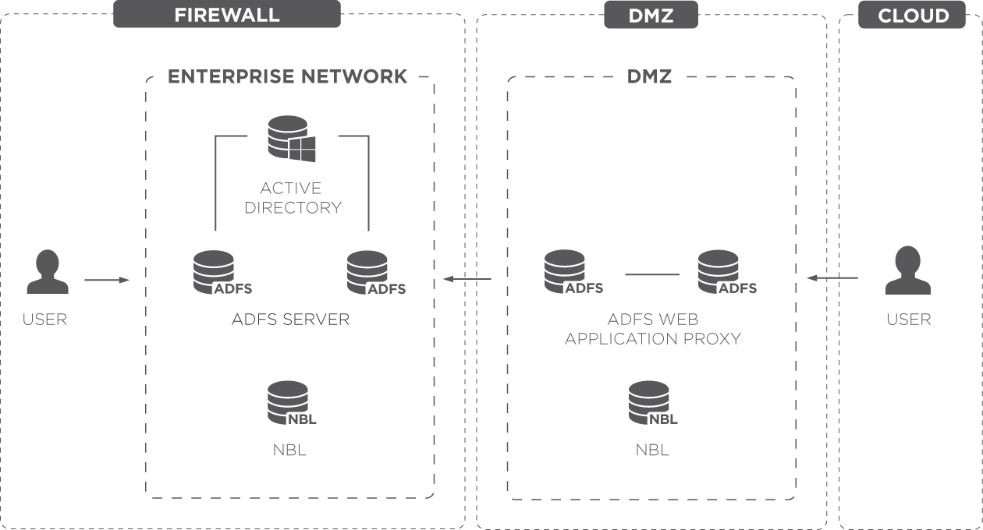
Active Directory
External Connections
  Specific servers are put into a Demilitarized zone accepting requests
  These specific DMZ machines are allowed access into the internal network
  DMZ network only allows specific traffic in and out
  Many DMZ servers are a type of proxy server

Slide 44

OS Interoperability
Specific tools are available to allow various operating systems to connect to Active Directory
  Centrify allows Linux hosts to authenticate against Active Directory
    Centrify also allows for finer-grained security access definitions specific to UNIX/Linux environments
  Many Linux variants have built-in Active Directory client authentication connection services
Samba provides file and print service interaction between UNIX/Linux hosts and Windows
  Samba can also replicate PDC/BDC functionality
  CIFS/NFS main Samba filesystem functionality

Slide 45

Samba
A suite of applications that helps UNIX based systems interoperate with Windows-based operating systems.
An open source implementation of the SMB/CIFS protocol suite
Provides printer and file sharing services to Windows (and other) clients
Samba can be used with LDAP for centralized login management
Samba uses multiple services (daemons)
  smbd: file sharing and printer services
  nmbd: handles NetBIOS name service requests (WINS)
  winbindd: used to query native Windows servers via MS RPC calls, PAM, and NSS

Slide 46
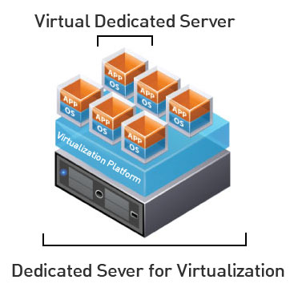
Virtual Machines
IP Address: 147.64.243.1## (01-25)
Hostname: cmac3990-1##.cs.edinboro.edu (01-25)
Alias: 41##.megastuff.biz (01-25)
Assignment 3 due September 12th 2025
  DNS server and zone configurations
Assignment 4 tasks covers Network Bonding and
LDAP server configurations
  Uses commands discussed during class
    Network Bonding next class…
  Due September 19 – run check script…
    https://jpatalon.cs.edinboro.edu/cmac3990/classfiles/assignment4-check.sh
  Don’t forget the documentation!

Slide 47
CMAC 3990.200
Systems Administration and Operations
Fall 2025 – Week 3.2 – September 11th, 2025
Directory Services and User Management
Network Hardware and Devices, LDAP, and SAMBA

Slide 48
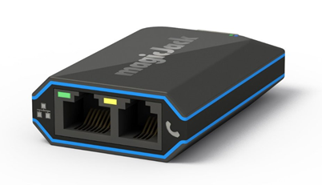
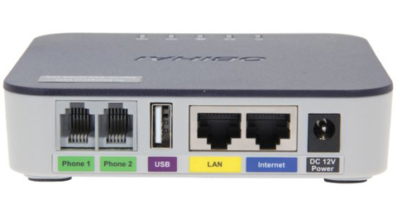
Network Devices
Home telephony
  Device connects to network and telephone
    May be able connect to home telephone network,
    powering multiple phones
  magicJack
    Caller ID, voicemail, call forwarding, etc
    Yearly service cost ($2-3/month)
    Additional fees for additional services (911!)
  OBiHai
    Can be used with Google Voice or other services
    No monthly/yearly fee (free service!)
    Additional fees for additional services (911!)
    Obsolete?!

Slide 49
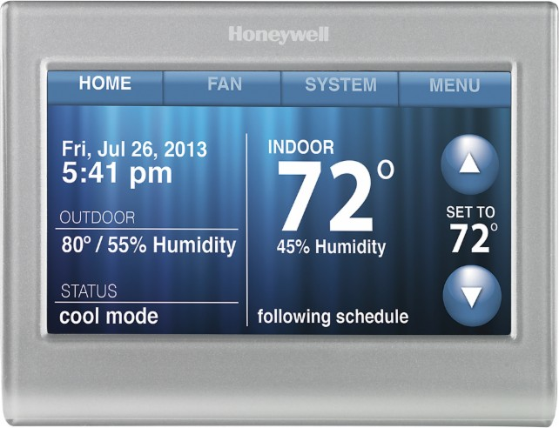
Internet of Things (IoT)
Connecting “dumb” devices to the internet to make them “smart”
  Thermostats, refrigerators, washing machines, dryers, lighting…
  Bio-connected items such as heart monitors or medicine pumps
Devices may be connected to intermediary network
  Devices communicate with RFID, X10, WiFi, or similar
  Intermediary network can communicate with computer network
Allows for advanced data collection
  Temperature swings, energy usage, notifications
Can also allow for interaction with devices
  Change temperature, start dishwasher, see what is in the fridge

Slide 50
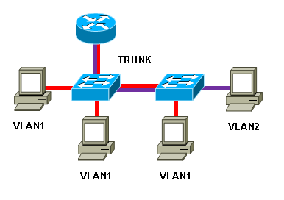
Virtual IP’s and Virtual LAN’s
Virtual Internet Protocol Address: VIP or VIPA
  An IP address that doesn't correspond to an actual physical network interface
  Useful for fault tolerance and mobility
  Considered to be a secondary IP, in addition to the server’s primary IP
Virtual Local Area Network: VLAN
  Uses VLAN Tagging Protocol – 802.1q
  Separates single physical networks into separate virtual networks
  Provides an additional layer of network security
    Subdivide a LAN into separate VLAN’s for separate traffic
  Trunking
    Multiple LAN’s on a single physical cable
  Requires supporting hardware!
    Switch, router, NIC, etc.

Slide 51
Network Bonding
The process of joining two or more network interfaces into a single interface
  Provides fault tolerance and redundancy
  Also called channel bonding, link aggregation, NIC teaming, and others
  Different types of bonding modes provide different features
    Round Robin – Default mode; packets are sent in order over each interface
    Active/Backup – One link is used, switched to secondary link in case of primary link failure
    XOR – Specific MAC address destinations are pinned to a specific interface
    Broadcast – All packets sent on all interfaces
    Link Aggregation – Interfaces are combined, increasing throughput
      Requires 802.3ad LACP switch support
    Transmit Load Balancing – Outgoing traffic is distributed depending on load
    Adaptive Load Balancing – Provides transmit and receive load balancing
    through ARP negotiation. Does not require specific switch configurations.

Slide 52
Network Bonding
The process of joining two or more network interfaces into a single interface
  Modes
  Link Monitoring
    Media independent interface monitor – MIIMON – Monitors the carrier state of the link
      Monitoring frequency – time between link state checks
      Link down delay – how long to wait before removing a link from the bond
      Link up delay – how long to wait before bringing a link back into the bond
    ARP Monitor – sends ARP queries to peers on the network to determine connectivity
      Monitoring frequency – time between ARP request transmissions
      ARP targets– a list of peer MAC addresses to query

Slide 53

Security-Enhanced Linux (SELinux)
SELinux is a kernel security module, that provides a mechanism for supporting access control policies
  Origins of SELinux can be traced to earlier projects by the NSA
  Provides a flexible mandatory access control (MAC) architecture into the major subsystems of the kernel
  Limits or reduces the ability of a compromised program to cause harm
  Independent of traditional Linux security access control mechanisms
  Capabilities of mandatory access controls, mandatory integrity controls, role-based access control (RBAC), and type enforcement architecture
    RBAC: Regulates access to a computer or network based on user roles
    Type enforcement: gives a subject access to objects based on rules in a security context
  Popular in container use
  Check status with getenforce command
    More detailed status information can be found with sestatus command
  Similar to AppArmor or Samsung Knox

Slide 54

Linux
Free and Open Source Software (FOSS)
  Free as in speech, not as in beer
  Source code readily available for anyone to view or modify
  Absolves programmers from liability
GNU Public License
  Dictates licensing behavior
  Software is free, may be modified and resold provided full source code
  and changes are released as open source
Kernel Differences
  Distribution vendors take a base kernel, add customized patching, perform additional QA
Upstream and Downstream
  Software project maintainers release tools and programs (upstream)
  Distribution vendors put software and tools together into a package (downstream)

Slide 55
Linux
Standards
  File Hierarchy Standard (FHS)
  Linux Standard Base (LSB)
Single, Multiple, Network User
  Windows originally a “one computer, one desk, one user” operating system
  Linux originally developed with networking and multiple users in mind
Registry and text files
  Windows uses a registry – a large database of configuration values
  Linux uses text files – small scattered configurations
Authentication
  Local and network

Slide 56

Linux Directory Structure
Root – Top level directory
  Represented by a forward slash /
  Similar to C:\ on Windows
/bin – User applications (binaries)
/sbin – System applications
/etc – Config files
/dev – Device files
  Virtual file systems!
/proc – Process Information
/var – Variable files
/usr – User programs
/opt – Additional optional programs
/home – Home directories
/root – Root user home directory
/boot – Boot loader files
/lib – System library files
/mnt – Mount directory
/tmp – Temporary files

Slide 57
Linux Commands
su – switch user command – allows user to impersonate another
  Most commonly used to impersonate root
sudo – switch user do (super user do) – run a command as another user
vi – visual editor – command driven text based editor
  Press i to switch to insert mode, esc to return to command mode
  Type command :wq! to save and close the file (write and quit)
  Most popular Unix/Linux editor
nano – simple text editor
  Caret symbol represents control button (^X = crtl+x)
gedit – graphical editor similar to Windows Notepad
joe – another simple editor

Slide 58
The Command Line
Directory structure navigation
  cd command lets us change directories
    cd /home/user/
  cd command by itself changes to users home directory
    cd
  Parent directory is represented by two periods
    cd ..
  pwd shows us what directory we are currently in
    [user@cmac3990-110 ~]$ pwd
    /home/user
  Files are edited with an editor
    vi, nano, joe, etc.
  Executables are executed
    /tmp/script.sh
The cd command (lowercase CD)

Slide 59
Linux Commands
mkdir – Make a directory
  Ex: mkdir /home/jpatalon/folder
useradd – add a new user
  Ex: useradd jpatalon
passwd – change a password
  Ex: passwd – Changes the password of the current user
  Ex: passwd jpatalon – Changes the password of user jpatalon
dnf – Manage installed packages and software
  dnf search <package>
  dnf install <package>
  dnf update
wget – download a file from the internet

Slide 60
Command Line Interface (CLI)
Background a job (&)
  Append an ampersand to the end of the command
    Ex: top &
  Bring the job into the foreground
    Ex: fg <job>
Environment Variables
  Various variables in your shell
    echo $SHELL
    var=asdf
    echo $var
  Variable can be numbers, words, letters, arrays, command output…
    var=$(cat /etc/fstab)
    var=`cat /etc/fstab`
      Backticks ^
Everything is case sensitive!

Slide 61
Command Line Interface (CLI)
Linux Shell
  Environment provided for a user; dictates commands and variable structures…
  BASH Shell – Bourne Again SHell
  C Shell
  KSH – Korn Shell
Tab completion (BASH)
  Type the first few letters, press tab, system will attempt to auto-complete
String multiple commands together
  Cat a file, grep for specific words, count the number of words
    Ex: cat /tmp/filename | grep words | wc
Man
  Run the man command to access manual pages!
    Ex: man which

Slide 62

Stream Editor (SED)
A text editor that edits information coming from input or files
Easily replace text within a file
Basic usage:
  sed [options] commands [file-to-edit]
Some simple examples:
  Replace all occurrences of the word “one” with the word “two” in a file
    sed -i ‘s/one/two/g’ file
  Delete a line that matches a pattern
    sed -i ‘/pattern/d’ file
  Can be combined with the pipe command to edit text inline

Slide 63
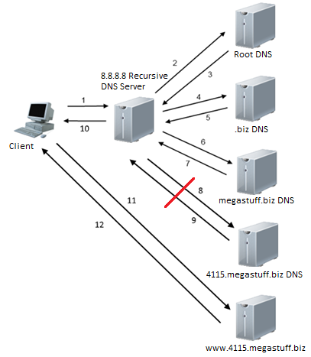
Why external DNS doesn’t work for our domains…
If we configure our servers to use Google’s free public
recursive DNS server 8.8.8.8, our query will fail!
Google’s 8.8.8.8 server cannot query our
41##.megastuff.biz name servers
  The EUP campus firewall prevents this!
The query cannot complete!
If we perform the same query against a
recursive DNS server in the CS network, the
query will succeed!
  We just changed our network configuration
  to make sure this will work!

Slide 64
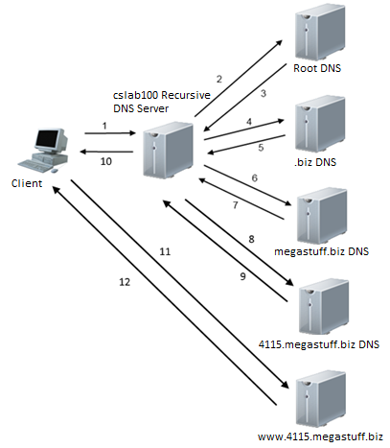
Why external DNS doesn’t work for our domains…
We will change our recursive DNS setting to use
the EUP CS servers cslab100.cs.edinboro.edu (147.64.242.100)
Since the cslab100 server is on the cs network,
it is not being blocked from querying our servers
Recursive queries against our servers from cslab100
should still be blocked, but the authoritative DNS
resolution will work!
  We don’t want to provide recursive DNS services
  to the entire campus!
  Recursive queries from 147.64.243.96/27 will work
    147.64.243.96 – 147.64.243.127
    We configured this in our /etc/named.conf file!

Slide 65
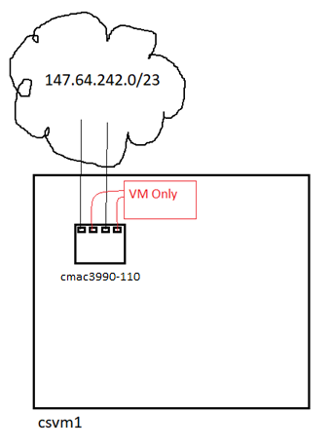
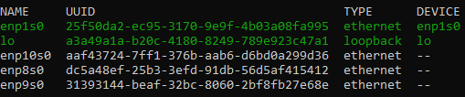
Our Network Config
Four Network Devices
  enp1s0 and enp8s0 are on the CS subnet 147.64.242.0/23
    We configured enp1s0 already
    We disabled enp8s0 as part of assignment 2
  enp9s0 and enp10s0 are on the private VM guest network
    enp9s0 and enp10s0 should be disabled from assignment 2

Slide 66
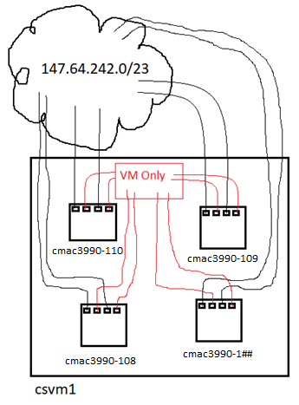
Our Network Config
Four Network Devices
  enp1s0 and enp8s0 are on the CS subnet 147.64.242.0/23
    We configured enp1s0 already
    We disabled enp8s0 as part of assignment 2
  enp9s0 and enp10s0 are on the private VM guest network
    enp9s0 and enp10s0 should be disabled from assignment 2
  Let us make some network changes!
    Create network bond master device bond0
      Reconfigure devices enp1s0 and enp9s0 to be slaves to bond0
    Clean up other network device files
      Make sure devices enp8s0 and enp10s0 are disabled

Slide 67

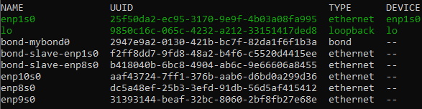
Network Changes
Lets Bond!
  Create a new network bond interface:
    nmcli con add type bond ifname mybond0 bond.options "mode=balance-rr,miimon=100"
      Balance-rr: Round robin traffic distribution between interfaces
      Miimon: interval for link status in milliseconds
  Add our network interfaces in to the bond:
    nmcli con add type ethernet ifname enp1s0 master bond-mybond0
    nmcli con add type ethernet ifname enp8s0 master bond-mybond0
  Disable the bond so we can reconfigure it:
    nmcli con down bond-mybond0
Assignment 4

Slide 68
Network Changes
Lets Bond!
  Configure the IP address, gateway, and DNS servers for our new network bond connection:
    nmcli con mod bond-mybond0 ipv4.method manual ipv4.addresses 147.64.243.1##/23
    nmcli con mod bond-mybond0 ipv4.gateway 147.64.242.1
    nmcli con mod bond-mybond0 ipv4.dns "147.64.242.100,8.8.8.8,8.8.4.4"
      Notice we added a new DNS server!
  Prevent the existing enp1s0 device from autoconnecting, and allow the bond0 device to autoconnect:
    nmcli con mod enp1s0 connection.autoconnect no
    nmcli con mod bond-mybond0 connection.autoconnect yes
Assignment 4

Slide 69
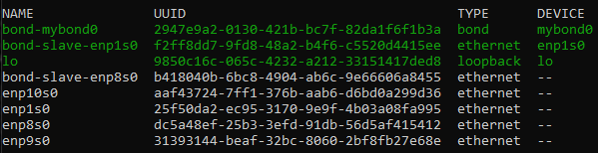
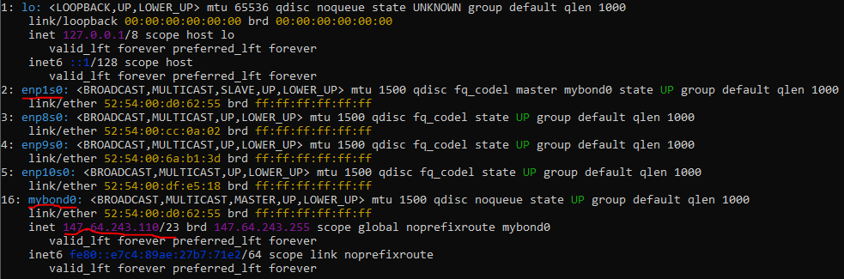
Network Changes
Lets Bond!
  Disable the enp1s0 device and enable the bond:
    nmcli con down enp1s0; nmcli con up bond-mybond0
      We put these two commands on the same line, so they are both executed with no interruption between!
      If you lose connectivity, you will need your OOB VNC connection to get in and fix it!
  Validate with the following commands:
    nmcli con show →
    ip addr show ↓
Assignment 4

Slide 70
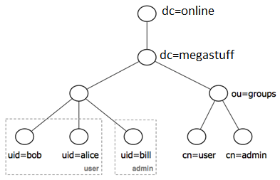
LDAP Client Installation
An LDAP server is configured on host cmac3990-110.cs.edinboro.edu
Disable SELinux (Security Enhanced Linux)
  Edit the file /etc/selinux/config to set boot-time config
    SELINUX=permissive
  Run the following command to set run-time config
    setenforce 0
Install the necessary packages
  dnf -y install openldap-clients sssd sssd-ldap oddjob-mkhomedir authselect-compat
Enable and start the oddjobd service
  systemctl enable oddjobd --now
Assignment 4

Slide 71
LDAP Client Installation
Connect to the LDAP server
  authselect select sssd with-mkhomedir --force
  authconfig --enableforcelegacy --update
  authconfig --enableldap --enableldapauth --ldapserver="ldap://147.64.243.110" --ldapbasedn="dc=megastuff,dc=biz" --update
  Authconfig command takes care of applying settings
Check if you can get user information from the LDAP server
  getent passwd ldapstudent01
Assignment 4

Slide 72
Samba Installation
Install the Samba packages
    dnf -y install samba samba-common-tools samba-client
Create the Samba file share directory and test file
    mkdir -p /share
    echo test > /share/sambadoc.txt
    chmod -R ugo+rwX /share
Define the share configuration – add to end of file /etc/samba/smb.conf
    [share]
    comment=This is the cmac3990 share
    path=/share
    public=yes
    writable=no
Allow samba connections through firewall
    firewall-cmd --add-service=samba --permanent
    firewall-cmd --reload
Assignment 4

Slide 73
Samba Installation
Start and enable samba
    systemctl start smb
    systemctl enable smb
Add samba user named “user”
    smbpasswd -a user
  Enter a password of “password”
Check and browse!
  Check: smbclient -L localhost -U user
  Browse: smbclient \\\\localhost\\share user
    Commands: ls, get, put, help, quit
    Similar to FTP commands
  Windows
    \\147.64.243.1##\
    \\147.64.243.1##\share
Windows 10 breaks this?!
Assignment 4

Slide 74
Linux Commands
ssh-keygen
vi/nano
useradd
passwd
cat
cd
pwd
touch
man
ls
chown
chgrp
chmod
ln
find
cp
mv
mkdir
rmdir
more
du
df
which
whereis
gzip
dig
nslookup
bzip2
tar
ps
top
kill
who
w
su
sudo
whois
dnf
firewall-cmd
reboot
shutdown
systemctl enable
systemctl start
systemctl stop
systemctl restart

Slide 75
Virtual Machines
IP Address: 147.64.243.1## (01-15)
Hostname: cmac3990-1##.cs.edinboro.edu (01-15)
Alias: 41##.megastuff.biz (01-15)
Assignment 3 tasks covers initial DNS server configurations
  Uses commands discussed during class
  Configure recursive and authoritative DNS server
  Due September 3rd – run check script!
    https://jpatalon.cs.edinboro.edu/cmac3990/classfiles/assignment3-check.sh
  Don’t forget the documentation!
Assignment 4 tasks cover LDAP and Network Bonding!
  Due September 19th ???

Slide 76

Key Terms and Items
Command Line Navigation
Runlevels
NIS
LDAP
  OU/CN/DC
AD
  Physical Architecture
  Logical Architecture
Samba
Individual VM’s
RAID 0, 1, 5, 10
SAN
NAS
ISP Tier
ISP Peer
ARP
TCP/UDP
VIP’s & VLAN’s

Slide 77

For Next Week
“Every morning in Africa, a gazelle wakes up, it knows it must outrun the fastest lion or it will be killed. Every morning in Africa, a lion wakes up. It knows it must run faster than the slowest gazelle, or it will starve. It doesn't matter whether you're the lion or a gazelle - when the sun comes up, you'd better be running.” – African Proverb
Homework Assignment 3 – Due September 12th, 2025
Homework Assignment 4 – Due September 19th, 2025
Textbook Reading
  Chapter 4: Process Control
  Chapter 5: The Filesystem
  Chapter 16: DNS
Continuing to work with VM’s
  Network and LDAP and Samba

